Slide 1
CSC 112: Computer Operating Systems Review Questions
Department of Computer Science,
Hofstra University

Slide 2
Q. Fork
For these questions, assume there is no error, i.e., all fork calls succeed, and the return value of fork() is never negative.
1. Will the parent and child print the same value for a?
ANS: Yes. Processes do not share the same memory space, so a is 2 for both.
2. Will they print the same memory address &a?
ANS: Yes. Fork copies the address space of the parent to the child.
3. Will they write to the same STDOUT?
ANS: Yes. File descriptors are copied over to the new process, so both STDOUTs will reference the same ”file”.
1 int main(void) {
2 int a = 1;
3 pid_t fork_ret = fork();
4 if (fork_ret > 0) {
5 a++;
6 fprintf(stdout, "Parent: int a is %d at %p\n", a, &a);
7 } else if (fork_ret == 0) {
8 a++;
9 fprintf(stdout, "Child: int a is %d at %p\n", a, &a);
10 } else {
11 printf("Oedipus");
12 }
13 }

Slide 3
Q. Fork
For these questions, assume there is no error, i.e., all fork calls succeed, and the return value of fork() is never negative.
1. What does this program print?
ANS: Currently, the program stops after printing 3, giving an output of
0
1
2
3
<output of ls>
1 int main(void) {
2 char** argv = (char**) malloc(3 * sizeof(char*));
3 argv[0] = "/bin/ls";
4 argv[1] = ".";
5 argv[2] = NULL;
6 for (int i = 0; i < 10; i++) {
7 printf("%d\n", i);
8 if (i == 3) {
9 execv("/bin/ls", argv);
10 }
11 }
12 return 0;
13 }

Slide 4
Q. Fork
For these questions, assume there is no error, i.e., all fork calls succeed, and the return value of fork() is never negative.
1. What does this program print?
ANS: The parent process will print from 0 to 9. The child process will print <output of ls> with any possible interleaving with the parent’s printing of 0 to 9.
0
1
2
…
9
<output of ls>
1 int main(void) {
2 char** argv = (char**) malloc(3 * sizeof(char*));
3 argv[0] = "/bin/ls";
4 argv[1] = ".";
5 argv[2] = NULL;
6 for (int i = 0; i < 10; i++) {
printf("%d\n", i);
if (i == 3) {
pid_t fork_ret = fork();
if (fork_ret == 0)
execv("/bin/ls", argv);
}
12 return 0;
13 }

Slide 5
Q. Dining Lawyers
Consider the Dining Lawyers problem. There are 3 lawyers P1 to P3, each with a different number of arms. P1 has 1 arm and needs 1 fork to eat; P2 has 2 arms and needs 2 forks to eat; P3 has 3 arms and needs 3 forks to eat. There is a pile of 3 forks at center of the table. Each lawyer picks up one fork at a time, and when he gets enough forks, he eats and then puts down all his forks.
Is it possible for the system to be deadlocked? If no, explain why. If yes, show a (potential) deadlock state and run Banker’s algorithm to check it. (You need to give the Max, Allocation, Need matrices, Total and Available vectors, and Available resources after completion of each process.)

Slide 6
Q. Dining Lawyers Solution: 3 Lawyers, each with 1,2,3 arms, 3 forks
Max
Allocation
Max
Allocation
Need
1
2
3
0
0
0
P2 grabs 1 fork and P3 grabs 2 forks
1
2
3
0
1
2
1
1
1
Initially, all forks are free.
Total
Available
Total
Available
Available resources after completion of each process
3
3
3
0
 | R1
Init | 0
Deadlock
Current state is a deadlock.

Slide 7
Q. Paging
Consider 12-bit virtual address space. Consider a machine with a page size of 1 KB. There are 8 KB of physical memory and 8KB of virtual memory. The TLB is a fully associative cache with space for 4 entries that is currently empty.
Assume that the physical page number is always one more than the virtual page number. This is a sequence of memory address accesses for a program:
0x294, 0xA76, 0x5A4, 0x923, 0xCFF, 0xA12, 0xF9F, 0x392, 0x341.
Here is the current state of the page table.
How many TLB hits and page faults are there? What are the contents of the TLB at the end of the sequence?
VPN | Valid | PPN
0 | 0 | /
1 | 1 | 2
2 | 0 | /
3 | 0 | 4
4 | 0 | 5
5 | 1 | 6
6 | 1 | 7
7 | 0 | /
Page Table
Notes:
Consider a machine with a page size of 1024 bytes. There are 8KB of physical memory and 8KB of virtual memory. The TLB is a fully associative cache with space for 4 entries that is currently empty. Assume that the physical page number is always one more than the virtual page number. This is a sequence of memory address accesses for a program we are writing: 0x294, 0xA76, 0x5A4, 0x923, 0xCFF, 0xA12, 0xF9F, 0x392, 0x341. Here is the current state of the page table. How many TLB hits and page faults are there? What are the contents of the TLB at the end of the sequence?

Slide 8
Given:
Page size: 1024 bytes (1KB)
Physical memory: 8KB (8 frames)
Virtual memory: 8KB (8 pages)
TLB: fully associative, 4 entries, initially empty
Physical page number = virtual page number + 1
Page size is 1 KB = 2^10, hence offset is 10 bits. 12-bit virtual address space, hence bits used for VPN indexing is 12-10=2 bits. VPN is the left-most 2 bits of the virtual address.
Looking up the page table, VPNs 1, 5, 6 are valid; others are invalid or marked as NULL.
Virtual Addr | VPN | TLB | Memory
0x294 | 0 | miss | PF
0xA76 | 2 | miss | PF
0x5A4 | 1 | miss | valid
0x923 | 2 | hit | valid
0xCFF | 3 | miss | PF
0xA12 | 2 | hit | valid
0xF9F | 3 | hit | valid
0x392 | 0 | hit | valid
0x341 | 0 | hit | valid
VPN | Valid | PPN
0 | 0 | /
1 | 1 | 2
2 | 0 | /
3 | 0 | 4
4 | 0 | 5
5 | 1 | 6
6 | 1 | 7
7 | 0 | /
Page Table
Notes:
0x294, 0xA76, 0x5A4, 0x923, 0xCFF, 0xA12, 0xF9F, 0x392, 0x341.

Slide 9
VPN | Valid | PPN
0 | 1 | 1
1 | 1 | 2
2 | 1 | 3
3 | 1 | 4
4 | 0 | 5
5 | 1 | 6
6 | 1 | 7
7 | 0 | /
Page Table
Tag | PPN
1 | 1
2 | 3
1 | 2
3 | 4
TLB

Slide 10
Q. Paging
Suppose the virtual and physical memory address spaces are both 32 bits with a 4KB page size.
1. Suppose you know that there will only be 4 processes running at the same time, each with a working set size of 256KB, i.e., it uses 256 KB memory most of the time. What is the minimum amount of TLB entries that your system would need to support to be able to map/cache the working set size for one process? What happens if you have more entries? What about if you have fewer entries?
ANS: A process has a working set size of 256KB which means that the working set fits in 256KB/4KB=64 pages. This means our TLB should have 64 entries. If you have more entries, then performance will increase since the process often has changing working sets, and it should be able to store more in the TLB. If it has less, then it can’t easily translate the addresses in the working set and performance will suffer.
2. Suppose you run some benchmarks on the system and you see that the system is utilizing over 99% of its paging disk IO capacity, but only 10% of its CPU. What is a combination of the of disk space and memory size that can cause this to occur? Assume you have TLB entries equal to the answer from the previous part.
ANS: The system is thrashing since there isn’t enough memory for the benchmark to run without the system page faulting and having to page in new pages. Since there will be 4 processes that have a working set of 256 KB each, swapping will occur as long as the physical memory size is under 1 MB. This happens regardless of the number of TLB entries and disk size. If the physical memory size is lower than the aggregate working set sizes, thrashing is likely to occur.
3. Among 1) increasing TLB size, 2) adding more disk space, and 3) adding more memory, which one would lead to the largest performance increase and why?
ANS: We should add more memory so that we won’t need to page in new pages as often.
Notes:
a Resident
Set Size (RSS) of 512MB and a

Slide 15
Q2. LRU
In a paging system with page replacement strategy LRU (least recently used), a process performs accesses to memory pages in the given reference sequence:
Reference sequence: 7, 0, 1, 2, 0, 3, 0, 4, 2, 3, 0, 3, 1, 2, 0
The physical memory size is three page frames. Fill in the table for the virtual memory page that is paged into the respective page frame at each given request in the reference sequence.
Page replacement Algorithms | LRU | Example | OS | Lec-27 | Bhanu Priya
https://www.youtube.com/watch?v=u23ROrlSK_g
Ref | 7 | 0 | 1 | 2 | 0 | 3 | 0 | 4 | 2 | 3 | 0 | 3 | 1 | 2 | 0
F1
F2
F3
ANS:
Notes:
7 0 1 2 0 3 0 4 2 3 0 3 1 2 0
7 7 2 2 2 4 4 4 0 0 0 2 2 2

Slide 16
Ref | 7 | 0 | 1 | 2 | 0 | 3 | 0 | 4 | 2 | 3 | 0 | 3 | 1 | 2 | 0
F1 | 7 | 7 | 7 | 2 | 2 | 2 | 2 | 4 | 4 | 4 | 0 | 0 | 0 | 0 | 0
F2 |  | 0 | 0 | 0 | 0 | 3 | 3 | 3 | 2 | 2 | 2 | 2 | 1 | 1 | 1
F3 |  |  | 1 | 1 | 1 | 1 | 0 | 0 | 0 | 3 | 3 | 3 | 3 | 2 | 2
FIFO: 12 page faults
Ref | 7 | 0 | 1 | 2 | 0 | 3 | 0 | 4 | 2 | 3 | 0 | 3 | 1 | 2 | 0
F1 | 7 | 7 | 7 | 2 | 2 | 2 | 2 | 4 | 4 | 4 | 0 | 0 | 0 | 2 | 2
F2 |  | 0 | 0 | 0 | 0 | 0 | 0 | 0 | 0 | 3 | 3 | 3 | 3 | 3 | 0
F3 |  |  | 1 | 1 | 1 | 3 | 3 | 3 | 2 | 2 | 2 | 2 | 1 | 1 | 1
LRU: 12 page faults
FIFO: 6 page faults
OPT: 4 page faults

Slide 17
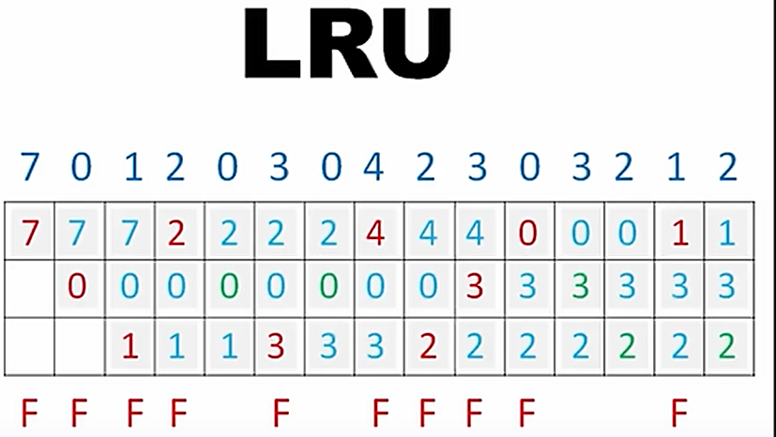
LRU
https://www.youtube.com/watch?v=4wVp97-uqr0

Slide 18
fork Example
void fork1() {
int x = 1;
pid_t fork_ret = fork();
if (fork_ret == 0)
printf("Child has x = %d\n", ++x);
else
printf("Parent has x = %d\n", --x);
printf("Bye from process %d with x = %d\n", getpid(), x);
}
Both parent and child start/continue execution after fork
Child gets a copy of parent’s data - both processes start with x = 1
Subsequent changes to x are independent
Shared open files - stdout is the same for both
Can’t predict execution order of parent and child - up to the OS!
Notes:
fork returns child’s PID to parent, 0 to child
Child = if case, parent = else

Slide 19
Modeling fork with Process Graphs
A process graph is a useful tool for capturing the partial ordering of statements in a concurrent program
Each vertex is the execution of a statement
a → b means a happens before b
Edges can be labeled with current value of variables
printf vertices can be labeled with output
Each graph begins with a vertex with no in-edges
Any topological sort of the graph corresponds to a feasible total ordering
Total ordering of vertices where all edges point from left to right
Notes:
Topological sort = any sort where vertices come after any vertex with a path to it

Slide 20
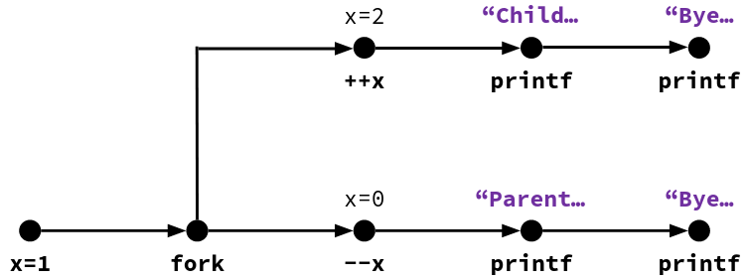
fork Example: Possible Output
void fork1() {
int x = 1;
pid_t fork_ret = fork();
if (fork_ret == 0)
printf("Child has x = %d\n", ++x);
else
printf("Parent has x = %d\n", --x);
printf("Bye from process %d with x = %d\n",
getpid(), x);
}
Notes:
Instructions within a branch must go in order, but CPU can switch between branches freely.
Child = if case = top line of diagram, parent = else case = bottom line of diagram

Slide 21
Polling Question
Which of the two sequences of outputs are possible?
Seq1 Seq2
L0 L0
L1 Bye
Bye L1
Bye L2
Bye Bye
L2 Bye
No No
No Yes
Yes No
Yes Yes
void nestedfork() {
printf("L0\n");
if (fork() == 0) {
printf("L1\n");
if (fork() == 0) {
printf("L2\n");
}
}
printf("Bye\n");
}
Notes:
Child 1 = first if case, child 2 = second if case (within first)
Parent: “L0”, fork child1, “Bye”
Child1: “L1”, fork child2, “Bye”
Child2: “L2”, “Bye”.
Seq1 impossible because “L2” cannot be the last thing printed
Seq2: parent, parent, child1, child2, child2, child1.
Answer: B

Slide 22
Fork-Exec
fork() creates a copy of the current process
exec*() replaces the current process’ code and address space with the code for a different program
Whole family of exec calls – see exec(3) and execve(2)
void fork_exec(char* path, char* argv[]) {
pid_t fork_ret = fork();
if (fork_ret != 0) {
printf("Parent: created a child %d\n", fork_ret);
} else {
printf("Child: about to exec a new program\n");
execv(path, argv);
}
printf("This line printed by parent only!\n");
}

Slide 23
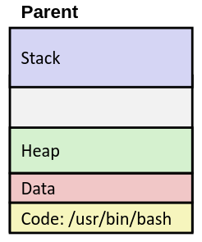
exec-ing a Program
Very high-level diagram of what happens when you run the command “ls” in a Linux shell
This is the loading part of CALL!

Slide 24
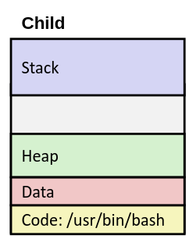
exec-ing a Program (pt 2)
Very high-level diagram of what happens when you run the command “ls” in a Linux shell
This is the loading part of CALL!
fork()

Slide 25
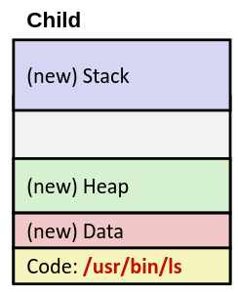
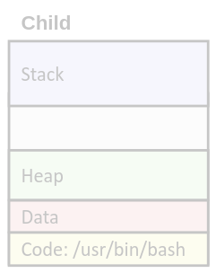
exec-ing a Program (pt 3)
Very high-level diagram of what happens when you run the command “ls” in a Linux shell
This is the loading part of CALL!
fork()
exec*()

Slide 26
Q4. Schedulability with Shared Resources
Consider the set of 3 periodic tasks scheduled with Rate Monotonic (RM) scheduling, with period, deadline, priority, and WCET parameters given in the table. Tasks 1 and 3 both require semaphore s₁.
1) Calculate priority ceilings of the semaphore s₁;
2) Determine taskset schedulability for Case (a) no PIP or PCP; Case (b) using PCP
Task | T | D | C | Prio | sems | CS Len | B | R
A | 100 | 50 | 25 | H | s₁ | 3
B | 200 | 100 | 50 | M | / | /
C | 300 | 300 | 100 | L | s₁ | 30
Notes:
Consider the set of 3 periodic tasks scheduled with RM, with period, deadline, priority, and WCET parameters given in the table. Tasks 1 and 3 both require semaphore s₁. Tasks 1 has critical section length 3, and Tasks 3 has critical section length 30. Under RM scheduling, use utilization bound and/or Response Time Analysis (RTA) to

Slide 27
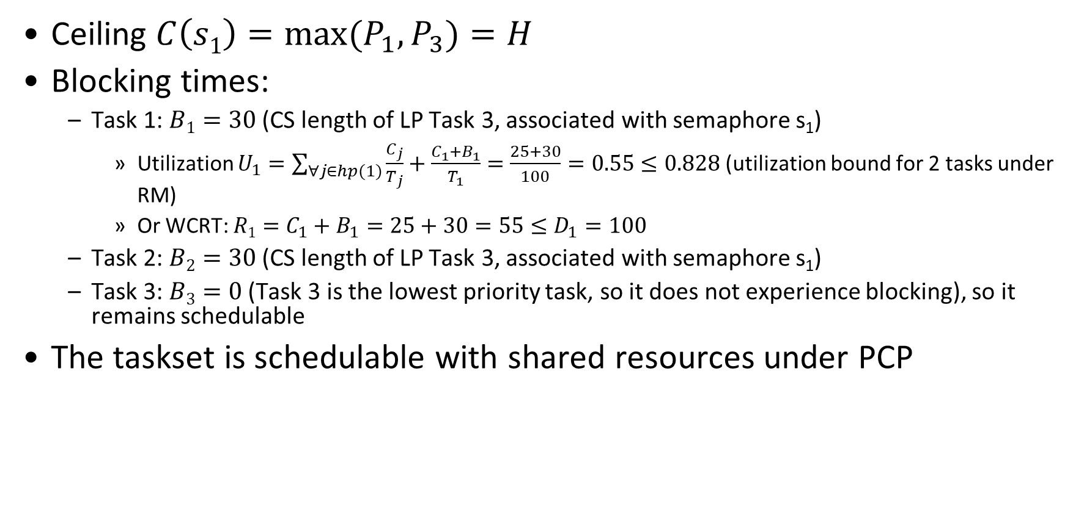
Q4. Schedulability with Shared Resources ANS
Ceiling $C\left(s1\right)=\max{(P_{1}, P_{3})}=H$
Blocking times:
Task 1: $B1=30$ (CS length of LP Task 3, associated with semaphore s₁)
Utilization $U_{1}=\sum_{∀j∈hp(1)}{\frac{C_{j}}{T_{j}}}+\frac{C_{1}+B_{1}}{T_{1}}=\frac{25+30}{100}=0.55≤0.828$ (utilization bound for 2 tasks under RM)
Or WCRT: $R1=C_{1}+B_{1}=25+30=55≤D_{1}=100$
Task 2: $B2=30$ (CS length of LP Task 3, associated with semaphore s₁)
Task 3: $B3=0$ (Task 3 is the lowest priority task, so it does not experience blocking), so it remains schedulable
The taskset is schedulable with shared resources under PCP
Task | T=D | C | Prio | sems | CS Len | B | R
1 | 100 | 25 | H | s₁ | 3
2 | 200 | 50 | M | / | /
3 | 300 | 100 | L | s₁ | 30

Slide 28
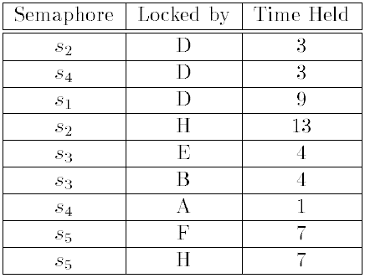
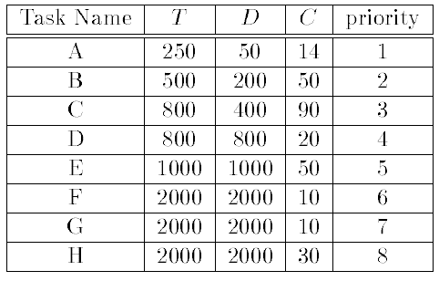
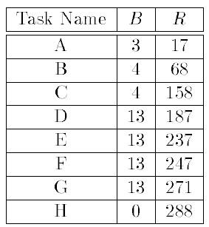
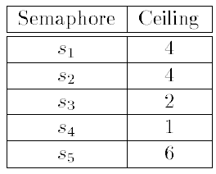
PCP Example II
Semaphores
Tasks (smaller number denotes higher priority)
2) s₂, s₃, s₅ required by LP tasks E, F, G, H
1) LP tasks E, F, G, H
Task D has blocking time max(13,4)=13, and WCRT=187
3) s₂, s₃ have ceilings with higher or equal prio than task D
Semaphore Ceilings

Slide 29
Blocking Time of Task D
Obtaining D’s blocking time
Tasks E, F, G, H have lower priority than D (priority number larger than prio(D)=4), and they require semaphores s₂, s₃ and s₅
s₂ and s₃ have ceilings ≥ prio(D)
Ceiling C(s₂)=max(prio), C(s₃) are higher or equal priority than task D
s₂ is required by task H for 13 ms; s₃ is required by task E for 4 ms (note that task B has higher priority than D, so it is not included)
Blocking time of D=MAX(13,4)=13
Other tasks’ blocking times can be obtained similarly.

Slide 30
Exam TODO
1. Multithreaded question, put each thread in a separate box, otherwise students may mistake it as a single threaded program.2.

Slide 31
Multiple choice questions for Final Exam
* What operations does NOT move a process to the ready state?
A) A process is launched/newly admitted into the system.
B) A process is pre-empted/interrupted by another process.
C) A process just issued an I/O request and is waiting for the I/O request to be completed.
D) A process issued an I/O request and the I/O request is just completed.
ANS: C
* Starvation in scheduling means that some processes may not get scheduled forever. Select the choice that consists of two starvation-free scheduling algorithms.
A) SJF, SRTF
B) FIFO, SJF
C) SJF, RR
D) FIFO, RR
ANS: D

Slide 32
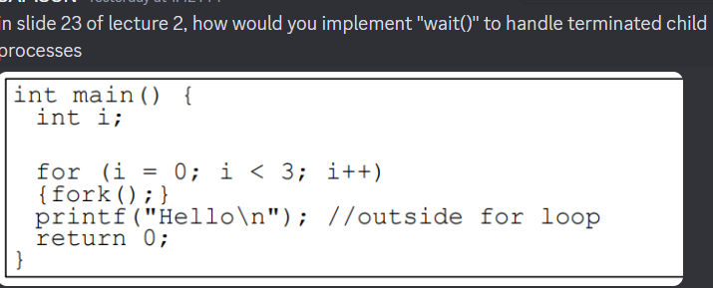
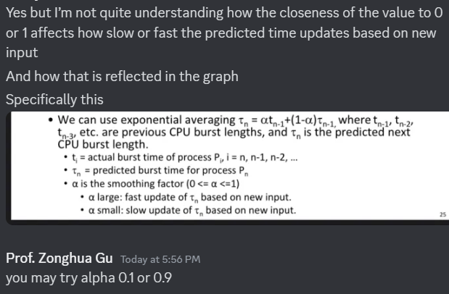

Slide 33
Adding wait()
Consider the following program. None of the parent processes include a wait() call to handle terminated child processes. When any of these child processes terminate, their PCBs remain in the process table as no parent process is waiting on them, resulting in zombie processes after the program finishes execution. Please modify the program by adding wait() calls to prevent zombie processes. (Write your modified program in the empty space below.)
int main() {
int i;
for (i = 0; i < 3; i++)
{fork();}
printf("Hello\n"); //outside for loop
return 0;
}

Slide 35
Fork
Consider the following example program. List all legal outputs this program may produce when executed on a Unix system. The output consists of strings made up of multiple letters.
int main() {
print (“A”);
int pid = fork();
print (“B”);
if (pid) wait(NULL);
print (“C”);
}

Slide 36
Fork ANS
ANS: Two possible answers: ABBCC and ABCBC
ABBCC
Scenario 1: Parent prints A, forks, prints B, then waits. Child prints B, exits after C. Parent resumes and prints C.
Order: A → parent B → child B → child C → parent C.
Scenario 2: Parent prints A, forks. Child prints B first, then parent prints B, parent waits, child prints C, and parent prints C.
Order: A → child B → parent B → child C → parent C.
ABCBC
Parent prints A, forks. Child runs first, prints B and C before the parent resumes. Parent then prints B, skips waiting (child already exited), and prints C.
Order: A → child B → child C → parent B → parent C.
Wait Synchronization: The parent’s wait(NULL) ensures the child’s C always appears before the parent’s C.

Slide 37
Scheduling
Here is a table of processes and their arrival and execution times.
1) Fill in the scheduling table with the Process ID (PID) that runs at each time instant, under 4 policies: First Come First Serve (FCFS), Shortest Job First (SJF), Shortest-Remaining-Time-First (SRTF), Round-Robin (RR) with timeslice quantum = 1. Assume that context switch overhead is 0 and that new RR processes are added to the head of the queue and new FCFS processes are added to the tail of the queue.
2) Compute the finish times and response times for all 5 processes, and the average response time. (If the division is hard, write a fraction like 28/5 instead of 5.6)

Slide 38
Scheduling
PID | Arriv. time | Exec Time | FCFS Finish Time | FCFS Response Time | SJF Finish Time | SJF Response Time | SRTF Finish Time | SRTF Response Time | RR Finish Time | RR Response Time
1 | 0 | 2
2 | 1 | 6
3 | 4 | 1
4 | 7 | 4
5 | 8 | 3
 |  | Average Turnaround |  | Avg RT |  | Avg RT |  | Avg RT |  | Avg RT
FCFS
SJF
SRTF
RR
Time | 0 | 1 | 2 | 3 | 4 | 5 | 6 | 7 | 8 | 9 | 10 | 11 | 12 | 13 | 14 | 15 | 16
Gantt Chart
Notes:
So, the average of 2, 7, 5, 6, and 8 is 5.6.
The average of the numbers 2, 7, 5, 9, and 4 is 5.4.
The average of the numbers 2, 8, 1, 9, and 4 is 4.8.
The average of the numbers 3, 12, 1, 9, and 7 is 6.4.

Slide 39
Scheduling
PID | Arriv. time | Exec Time | FCFS Finish Time | FCFS Response Time | SJF Finish Time | SJF Response Time | SRTF Finish Time | SRTF Response Time | RR Finish Time | RR Response Time
1 | 0 | 2 | 2 | 2 | 2 | 2 | 2 | 2 | 3 | 3
2 | 1 | 6 | 8 | 7 | 8 | 7 | 9 | 8 | 13 | 12
3 | 4 | 1 | 9 | 5 | 9 | 5 | 5 | 1 | 5 | 1
4 | 7 | 4 | 13 | 6 | 16 | 9 | 16 | 9 | 16 | 9
5 | 8 | 3 | 16 | 8 | 12 | 4 | 12 | 4 | 15 | 7
 |  | Average Turnaround |  | Avg RT 5.6 |  | Avg RT 5.4 |  | Avg RT 4.8 |  | Avg RT 6.4
FCFS | 1 | 1 | 2 | 2 | 2 | 2 | 2 | 2 | 3 | 4 | 4 | 4 | 4 | 5 | 5 | 5
SJF | 1 | 1 | 2 | 2 | 2 | 2 | 2 | 2 | 3 | 5 | 5 | 5 | 4 | 4 | 4 | 4
SRTF | 1 | 1 | 2 | 2 | 3 | 2 | 2 | 2 | 2 | 5 | 5 | 5 | 4 | 4 | 4 | 4
RR | 1 | 2 | 1 | 2 | 3 | 2 | 2 | 4 | 5 | 2 | 4 | 5 | 2 | 4 | 5 | 4
Time | 0 | 1 | 2 | 3 | 4 | 5 | 6 | 7 | 8 | 9 | 10 | 11 | 12 | 13 | 14 | 15 | 16
Gantt Chart
B arrives
C arrives
Notes:
So, the average of 2, 7, 5, 6, and 8 is 5.6.
The average of the numbers 2, 7, 5, 9, and 4 is 5.4.
The average of the numbers 2, 8, 1, 9, and 4 is 4.8.
The average of the numbers 3, 12, 1, 9, and 7 is 6.4.

Slide 40
Scheduling
Here is a table of processes and their arrival and execution times.
1) Fill in the scheduling table with the Process ID (PID) that runs at each time instant, under 4 policies: First Come First Serve (FCFS), Shortest Job First (SJF), Shortest-Remaining-Time-First (SRTF), Round-Robin (RR) with timeslice quantum = 1. Assume that context switch overhead is 0 and that new RR processes are added to the head of the queue and new FCFS processes are added to the tail of the queue.
2) Compute the finish times and response times for all 5 processes, and the average response time. (If the division is hard, write a fraction like 28/5 instead of 5.6)

Slide 41
Scheduling
PID | Arriv. time | Exec Time | FCFS Finish Time | FCFS Response Time | SJF Finish Time | SJF Response Time | SRTF Finish Time | SRTF Response Time | RR Finish Time | RR Response Time
1 | 0 | 3
2 | 1 | 5
3 | 3 | 2
4 | 9 | 2
 |  | Average Turnaround |  | Avg RT |  | Avg RT |  | Avg RT |  | Avg RT
FCFS
SJF
SRTF
RR
Time | 0 | 1 | 2 | 3 | 4 | 5 | 6 | 7 | 8 | 9 | 10 | 11 | 12
Gantt Chart
B arrives
C arrives
Notes:
So, the average of 2, 7, 5, 6, and 8 is 5.6.
The average of the numbers 2, 7, 5, 9, and 4 is 5.4.
The average of the numbers 2, 8, 1, 9, and 4 is 4.8.
The average of the numbers 3, 12, 1, 9, and 7 is 6.4.

Slide 42
Scheduling
PID | Arriv. time | Exec Time | FCFS Finish Time | FCFS Response Time | SJF Finish Time | SJF Response Time | SRTF Finish Time | SRTF Response Time | RR Finish Time | RR Response Time
1 | 0 | 3 | 3 | 3 | 3 | 3 | 3 | 3 | 6 | 6
2 | 1 | 5 | 8 | 7 | 8 | 7 | 10 | 9 | 11 | 10
3 | 3 | 2 | 10 | 7 | 10 | 7 | 5 | 2 | 7 | 4
4 | 9 | 2 | 12 | 3 | 12 | 3 | 12 | 3 | 12 | 3
 |  | Average Turnaround |  | Avg RT 5 |  | Avg RT 5 |  | Avg RT 4.25 |  | Avg RT 5.75
FCFS | 1 | 1 | 1 | 2 | 2 | 2 | 2 | 2 | 3 | 3 | 4 | 4
SJF | 1 | 1 | 2 | 2 | 2 | 2 | 2 | 2 | 3 | 3 | 4 | 4
SRTF | 1 | 1 | 1 | 3 | 3 | 2 | 2 | 2 | 2 | 2 | 4 | 4
RR | 1 | 2 | 1 | 3 | 2 | 1 | 3 | 2 | 2 | 4 | 2 | 4
Time | 0 | 1 | 2 | 3 | 4 | 5 | 6 | 7 | 8 | 9 | 10 | 11 | 12
Gantt Chart
B arrives
C arrives
Notes:
So, the average of 2, 7, 5, 6, and 8 is 5.6.
The average of the numbers 2, 7, 5, 9, and 4 is 5.4.
The average of the numbers 2, 8, 1, 9, and 4 is 4.8.
The average of the numbers 3, 12, 1, 9, and 7 is 6.4.

Slide 43
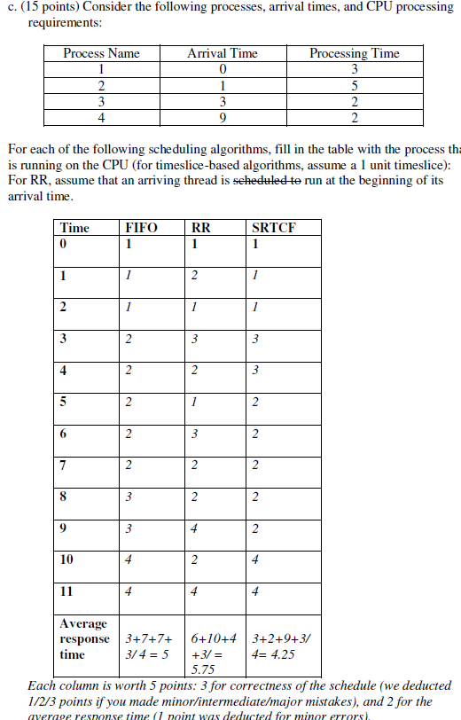
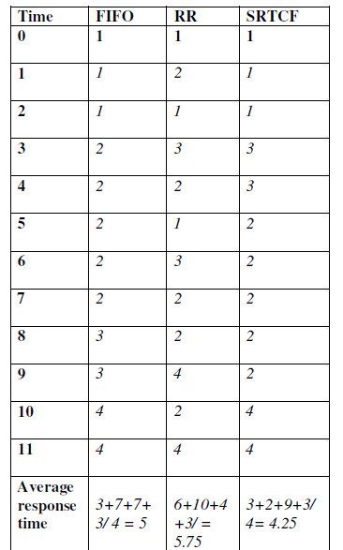

Slide 44
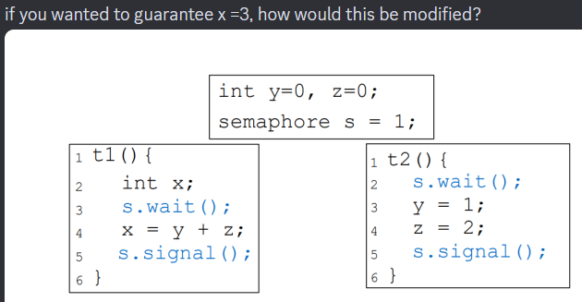
Modify this program by adding or removing semaphore operations to ensure that after both threads finish execution,
(1) x = 0
(2) Or, x=1
(3) Or, x=3

Slide 46
Resource Allocation Graph Examples
R₁
R₂
R₁
R₂
R₁
T₂
T₁
T₂
T₃
T₁
T₂
T₃
T₁
T₃
R₃
T₄
R₄
R₃
R₂
R₄
No Cycle;
No Deadlock
Deadlock (cycle R₃->T₂->R₂->T₃
And cycle R₃->T₁->R₁->T₂->R₂->T₃
Cycle,
but No Deadlock
(T₂ or T₄ may release
res later)
Notes:
Animation: http://cs.uttyler.edu/Faculty/Rainwater/COSC3355/Animations/deadlock.htm

Slide 47
(1) No Deadlock Morning Exam
Max
Allocation
Need
 | R1 | R2 | R3 | R4
T1 | 1 | 0 | 1 | 0
T2 | 1 | 1 | 1 | 0
T3 | 0 | 1 | 0 | 1
 | R1 | R2 | R3 | R4
T1 | 0 | 0 | 1 | 0
T2 | 1 | 0 | 1 | 0
T3 | 0 | 1 | 0 | 1
 | R1 | R2 | R3 | R4
T1 | 1 | 0 | 0 | 0
T2 | 0 | 1 | 0 | 0
T3 | 0 | 0 | 0 | 0
R₁
R₂
T₁
T₂
T₃
Total
Available
Available resources after completion of each process
R1 | R2 | R3 | R4
1 | 1 | 2 | 3
R1 | R2 | R3 | R4
0 | 0 | 0 | 2
 | R1 | R2 | R3 | R4
 | 0 | 0 | 0 | 2
T3
T2
T1
R₃
Run Banker’s algorithm to check if the current state is safe. If yes, give a safe sequence of process completions and fill in the table with the sequence of process completions without deadlock, and available resources after the completion of each process.
R₄

Slide 48
(1) No Deadlock ANS Morning Exam
Max
Allocation
Need
 | R1 | R2 | R3 | R4
T1 | 1 | 0 | 1 | 0
T2 | 1 | 1 | 1 | 0
T3 | 0 | 1 | 0 | 1
 | R1 | R2 | R3 | R4
T1 | 0 | 0 | 1 | 0
T2 | 1 | 0 | 1 | 0
T3 | 0 | 1 | 0 | 1
 | R1 | R2 | R3 | R4
T1 | 1 | 0 | 0 | 0
T2 | 0 | 1 | 0 | 0
T3 | 0 | 0 | 0 | 0
R₁
R₂
T₁
T₂
T₃
Total
Available
R1 | R2 | R3 | R4
1 | 1 | 2 | 3
R1 | R2 | R3 | R4
0 | 0 | 0 | 2
Available
 | R1 | R2 | R3 | R4
 | 0 | 0 | 0 | 2
T3 | 0 | 1 | 0 | 3
T2 | 1 | 0 | 1 | 3
T1 | 1 | 1 | 2 | 3
R₃
R₄
Safe Sequence: T3, T2, T1

Slide 49
(1) Deadlock ANS Morning Exam
Max
Allocation
Need
 | R1 | R2 | R3 | R4
T1 | 1 | 0 | 1 | 0
T2 | 1 | 1 | 1 | 0
T3 | 0 | 1 | 1 | 0
 | R1 | R2 | R3 | R4
T1 | 0 | 0 | 1 | 0
T2 | 1 | 0 | 1 | 0
T3 | 0 | 1 | 0 | 0
 | R1 | R2 | R3 | R4
T1 | 1 | 0 | 0 | 0
T2 | 0 | 1 | 0 | 0
T3 | 0 | 0 | 1 | 0
R₁
R₂
T₁
T₂
T₃
Total
Available
R1 | R2 | R3 | R4
1 | 1 | 2 | 3
R1 | R2 | R3 | R4
0 | 0 | 0 | 3
Deadlock, no safe sequence
R₃
R₄

Slide 50
(1) Deadlock Evening Exam
Max
Allocation
Need
 | R1 | R2 | R3 | R4
T1 | 1 | 0 | 1 | 0
T2 | 1 | 0 | 1 | 0
T3 | 0 | 1 | 1 | 0
 | R1 | R2 | R3 | R4
T1 | 0 | 0 | 1 | 0
T2 | 1 | 0 | 1 | 0
T3 | 0 | 1 | 0 | 0
 | R1 | R2 | R3 | R4
T1 | 1 | 0 | 0 | 0
T2 | 0 | 1 | 0 | 0
T3 | 0 | 0 | 1 | 0
R₁
R₂
T₁
T₂
T₃
Total
Available
Available resources after completion of each process
R1 | R2 | R3 | R4
1 | 1 | 2 | 3
R1 | R2 | R3 | R4
0 | 0 | 0 | 3
 | R1 | R2 | R3 | R4
 | 0 | 0 | 0 | 3
T3 | 0 | 1 | 0 | 3
T2 | 1 | 1 | 1 | 3
T1 | 1 | 1 | 2 | 3
 | R1 | R2 | R3 | R4
 | 0 | 0 | 0 | 3
T2 | 1 | 0 | 1 | 3
T3 | 1 | 1 | 1 | 3
T1 | 1 | 1 | 2 | 3
Safe sequence T3, T2, T1 or T2, T3, T1
R₃
R₄

Slide 51
Exam Quiz 1: Dining Lawyers
Consider the Dining Lawyers problem. There are 3 lawyers P1 to P3. Each lawyer has 4 arms, and there is a pile of knives and forks at center of the table. Each lawyer follows the following steps:
(1) Pick up a knife
(2) Pick up another knife
(3) Pick up a fork
(4) Pick up another fork
(5) Eat
(6) Return the knife and fork to the pile
Use Banker’s algorithm to check if it is possible for the system to get into a deadlock.
1) The pile contains 3 knives and 2 forks. (Yes deadlock on knives)
2) The pile contains 4 knives and 2 forks. (Yes deadlock on forks)
3) The pile contains 4 knives and 3 forks. (No deadlock)
4) The pile contains 4 knives and 3 forks. (No deadlock)
For each question, please write out the initial state encoded in 3 matrices Max, Allocation, Need, and 2 vectors Total and Available. If there is no possible deadlock, explain why. If there is a (potential) deadlock, show an unsafe system state and use Banker’s algorithm to check it.
Notes:
3 knives, all 3 lawyers blocked on knives.
4 knives, not possible for 3 lawyers to be blocked on knives. At most two lawyers can get past knives and try grab forks. If 2 forks, each holds a fork, deadlock. If 3 forks, not possible to deadlock since only 2 lawyers try grab forks,
and Available resources after completion of each process.)

Slide 52
Quiz 2: Dining Lawyers Solution: 3 lawyers, each with 4 arms, 3 knives and 2 forks
Max
Allocation
Max
Allocation
Need
Initially, all knives and forks are free.
2 | 2
2 | 2
2 | 2
0 | 0
0 | 0
0 | 0
P1 grabs 2 knives and 1 fork; P2 grabs 2 knives and 1 fork.
2 | 2
2 | 2
2 | 2
1 | 0
1 | 0
1 | 0
1 | 2
1 | 2
1 | 2
Total
Available
Total
Available
3 | 2
3 | 2
4 | 2
0 | 2
Available resources after completion of each process
 | K | F
Init | 0 | 0
Deadlock
Current state is deadlocked on knives.
It is not possible for the lawyers to be deadlocked on forks.

Slide 53
Quiz 2: Dining Lawyers Solution: 3 lawyers, each with 4 arms, 4 knives and 2 forks
Max
Allocation
Max
Allocation
Need
Initially, all knives and forks are free.
2 | 2
2 | 2
2 | 2
0 | 0
0 | 0
0 | 0
P1 grabs 2 knives and 1 fork; P2 grabs 2 knives and 1 fork.
2 | 2
2 | 2
2 | 2
2 | 1
2 | 1
0 | 0
0 | 1
0 | 1
2 | 2
Total
Available
Total
Available
4 | 2
4 | 2
4 | 2
0 | 0
Available resources after completion of each process
 | K | F
Init | 0 | 0
Deadlock
Current state is deadlocked on forks.
It is not possible for the lawyers to be deadlocked on knives, but possible to deadlock on forks

Slide 54
Quiz 2: Dining Lawyers Solution: 3 lawyers, each with 4 arms, 4 knives and 3 forks
Max
Allocation
Max
Allocation
Need
Initially, all knives and forks are free.
2 | 2
2 | 2
2 | 2
0 | 0
0 | 0
0 | 0
Not possible to get into deadlock
2 | 2
2 | 2
2 | 2
2 | 1
2 | 2
0 | 0
0 | 1
0 | 0
2 | 2
Total
Available
Total
Available
4 | 3
4 | 3
4 | 3
0 | 0
Available resources after completion of each process
 | K | F
Init | 4 | 2
P1 | 1
P2
It is not possible for the lawyers to be deadlocked on either knives or forks

Slide 55
Exam Quiz 1: Dining Lawyers
Consider the Dining Lawyers problem. There are 2 lawyers P1 to P2. Each lawyer has 4 arms, and there is a pile of knives and forks at center of the table. Each lawyer follows the following steps:
(1) Pick up a knife
(2) Pick up another knife
(3) Pick up a fork
(4) Pick up another fork
(5) Eat
(6) Return the knife and fork to the pile
Use Banker’s algorithm to check if it is possible for the system to get into a deadlock for the following cases:
1) The pile contains 2 knives and 2 forks. (Yes deadlock on knives)
2) The pile contains 3 knives and 2 forks. (No deadlock)
3) The pile contains 4 knives and 2 forks. (Yes deadlock, on forks)
4) The pile contains 4 knives and 3 forks. (No deadlock)
For each question, please write out the initial state encoded in 3 matrices Max, Allocation, Need, and 2 vectors Total and Available. If there is no possible deadlock, explain why. If there is a (potential) deadlock, show an unsafe system state and use Banker’s algorithm to check it.
Notes:
3 knives, all 3 lawyers blocked on knives.
4 knives, not possible for 3 lawyers to be blocked on knives. At most two lawyers can get past knives and try grab forks. If 2 forks, each holds a fork, deadlock. If 3 forks, not possible to deadlock since only 2 lawyers try grab forks,
and Available resources after completion of each process.)

Slide 56
Quiz 2: Dining Lawyers Solution: 2 lawyers, each with 4 arms, 2 knives and 2 forks
Max
Allocation
Max
Allocation
Need
Initially, all knives and forks are free.
2 | 2
2 | 2
0 | 0
0 | 0
P1 grabs 1 knife; P2 grabs 1 knife.
2 | 2
2 | 2
1 | 0
1 | 0
1 | 2
1 | 2
Total
Available
Total
Available
2 | 2
2 | 2
2 | 2
0 | 2
Available resources after completion of each process
 | K | F
Init | 0 | 2
Deadlock
Current state is deadlocked on knives.

Slide 57
Quiz 2: Dining Lawyers Solution: 2 lawyers, each with 4 arms, 3 knives and 2 forks
Max
Allocation
Max
Allocation
Need
Initially, all knives and forks are free.
2 | 2
2 | 2
0 | 0
0 | 0
P1 grabs 2 knives and then 2 forks; P2 grabs 1 knife.
2 | 2
2 | 2
2 | 0
1 | 0
1 | 2
1 | 2
Total
Available
Total
Available
3 | 2
3 | 2
3 | 2
0 | 2
Available resources after completion of each process
 | K | F
Init | 0 | 2
P1 | 2 | 2
P2 | 3 | 2
It is not possible for deadlock.

Slide 58
Quiz 2: Dining Lawyers Solution: 2 lawyers, each with 4 arms, 4 knives and 2 forks
Max
Allocation
Max
Allocation
Need
Initially, all knives and forks are free.
2 | 2
2 | 2
0 | 0
0 | 0
P1 grabs 1 knife; P2 grabs 1 knife.
2 | 2
2 | 2
2 | 1
2 | 1
0 | 1
0 | 1
Total
Available
Total
Available
4 | 2
4 | 2
4 | 2
0 | 0
Available resources after completion of each process
 | K | F
Init | 0 | 0
Deadlock
Current state is deadlocked on forks.

Slide 59
Quiz 2: Dining Lawyers Solution: 2 lawyers, each with 4 arms, 4 knives and 3 forks
Max
Allocation
Max
Allocation
Need
Initially, all knives and forks are free.
2 | 2
2 | 2
0 | 0
0 | 0
P1 grabs 1 knife; P2 grabs 1 knife.
2 | 2
2 | 2
2 | 2
2 | 1
0 | 1
0 | 1
Total
Available
Total
Available
4 | 3
4 | 3
4 | 3
0 | 0
Available resources after completion of each process
 | K | F
Init | 0 | 0
P1 | 2 | 2
P2 | 4 | 3
Current state is deadlocked on forks.

Slide 60
PID | Arriv. time | Priority | CPU Burst | IO Burst | CPU Burst
1 | 0 | 2 | 1 | 5 | 3
2 | 2 | 1 | 3 | 3 | 1
3 | 3 | 3 | 2 | 3 | 1
 |  |  | Avg RT |  | Avg RT

Slide 61
Wait() III
Output: 4 possible outputs
1) These 2 statements interleaved in any order:
Hello from Parent 0
Hello from Child 0
2) Hello from Parent again 0
3) These 2 statements interleaved in any order:
Hello from Parent 1
Hello from Child 1
4) Hello from Parent again 1
Parent exiting
int main() {
int i;
for (i = 0; i < 2; i++) {
pid_t pid = fork();
if (pid == 0) {
// Child process
printf("Hello from Child %d\n", i);
return 0; // Exit child process
} else if (pid > 0) {
// Parent process
printf("Hello from Parent %d\n", i);
wait(NULL); // Wait for immediate child to terminate
printf("Hello from Parent again %d\n", i);
}
}
printf("Parent exiting\n");
return 0;
}
Notes:
Hello 0
Hello 1
Parent exiting

Slide 62
Wait() III
start
int main() {
int i;
for (i = 0; i < 2; i++) {
pid_t pid = fork();
if (pid == 0) {
// Child process
printf("Hello from Child %d\n", i);
return 0; // Exit child process
} else if (pid > 0) {
// Parent process
printf("Hello from Parent %d\n", i);
wait(NULL); // Wait for immediate child to terminate
printf("Hello from Parent again %d\n", i);
}
}
printf("Parent exiting\n");
return 0;
}
59101
parent continues
pid=fork()
child
process created
59102
“Hello from Parent 0”
“Hello from Child 0”
wait(NULL)
return 0
“Hello from Parent again 0”
child
process created
pid=fork()
59102
“Hello from Parent 1”
“Hello from Child 1”
wait(NULL)
return 0
“Hello from Parent again 1”
“Parent exiting”
Notes:
Hello 0
Hello 1
Parent exiting

Slide 63
Wait() IV
int main() {
int i;
for (i = 0; i < 2; i++) {
pid_t pid = fork();
if (pid == 0) {
// Child process
printf("Hello from Child %d\n", i);
return 0; // Exit child process
} else if (pid > 0) {
// Parent process
continue();
}
}
// Parent process waits for all child processes to terminate
for (i = 0; i < 2; i++) {
printf("Hello from Parent %d\n", i);
wait(NULL); // Wait for a child process to terminate
printf("Hello from Parent again %d\n", i);
}
printf("Parent exiting\n");
return 0;
}
These statements interleaved in some order:
Hello from Parent 0
Hello from Child 0
Hello from Parent 1
Hello from Child 1
Hello from Parent again 0
Hello from Parent again 1
With constraints:
Each "Parent X" and "Child X" message pair appears before the corresponding "Parent again X" message, i.e.,
“Hello from Parent 0”, “Hello from Child 0” must appear before “Hello from Parent again 0”
“Hello from Parent 1”, “Hello from Child 1” must appear before “Hello from Parent again 1”
A final "Parent exiting" message printed last.
Notes:
Your program contains a logical issue: the continue(); statement in the else if (pid > 0) block is invalid because continue is not a function but a control flow statement. It should be written without parentheses, like this:
c
continue;
Once this is fixed, we can analyze the behavior of the program.
Corrected Code:
c
#include <stdio.h> #include <sys/wait.h> #include <unistd.h> int main() { int i; for (i = 0; i < 2; i++) { pid_t pid = fork(); if (pid == 0) { // Child process printf("Hello from Child %d\n", i); return 0; // Exit child process } else if (pid > 0) { // Parent process continue; // Skip to the next iteration of the loop } } // Parent process waits for all child processes to terminate for (i = 0; i < 2; i++) { printf("Hello from Parent %d\n", i); wait(NULL); // Wait for a child process to terminate printf("Hello from Parent again %d\n", i); } printf("Parent exiting\n"); return 0; }
Key Observations:
fork() Behavior:
Each call to fork() creates a new child process.
Both the parent and child processes execute concurrently from the point where fork() was called.
The return value of fork() determines whether the process is the parent (pid > 0) or the child (pid == 0).
Parent-Child Execution Order:
The parent skips any further logic in the loop after creating a child by using continue. This means that after creating a child, the parent immediately proceeds to create another child in the next iteration of the loop without waiting for the previous one to terminate.
Number of Processes:
The loop runs twice (i = 0 and i = 1), so two child processes are created in total.
Parent Waiting:
After exiting the loop, the parent waits for all child processes to terminate using a separate loop with wait(NULL).
Output Variability:
Since the parent does not wait for each child immediately after creating it, the outputs of "Hello from Child" messages can interleave with each other or with messages from the parent.
Detailed Execution Flow:
Iteration 1 (i = 0):
The parent process creates a child process (pid = fork()).
If pid == 0 (child process):
Prints: Hello from Child 0
Exits with return 0.
If pid > 0 (parent process):
Skips to the next iteration of the loop using continue.
Iteration 2 (i = 1):
The same logic applies as in iteration 1, but with i = 1.
After both iterations, the parent waits for all child processes to terminate using wait(NULL) in a separate loop. For each terminated child, it prints:
Hello from Parent %d
Waits for termination.
Prints: Hello from Parent again %d.
Finally, it prints Parent exiting before terminating.
Possible Outputs:
Since the parent does not wait immediately after creating each child, there is variability in how "Hello" messages from children interleave with those from the parent. However, due to the final waiting loop (wait(NULL)), "Parent exiting" is always printed last.
Here are some possible outputs:
Case 1:
text
Hello from Child 0 Hello from Child 1 Hello from Parent 0 Hello from Parent again 0 Hello from Parent 1 Hello from Parent again 1 Parent exiting
Case 2:
text
Hello from Child 1 Hello from Child 0 Hello from Parent 0 Hello from Parent again 0 Hello from Parent 1 Hello from Parent again 1 Parent exiting
Case 3:
text
Hello from Child 0 Hello from Parent 0 Hello from Child 1 Hello from Parent again 0 Hello from Parent 1 Hello from Parent again 1 Parent exiting
Case N... (Variations):
The order of "Child" and "Parent" messages can vary depending on how processes are scheduled by the operating system.
Key Notes:
Why Variability?
The parent does not wait for each child immediately after creating it. This allows children and parents to execute concurrently, leading to interleaved outputs.
Final Message ("Parent exiting")
This is printed only by the original parent process after all children have terminated.
Behavior of wait(NULL):
The wait(NULL) loop ensures that all children terminate before "Parent exiting" is printed.
Summary:
The program has many possible outputs due to concurrent execution and scheduling variability. However, all outputs will include:
Two "Child" messages (Hello from Child X) in some order.
Two "Parent" messages (Hello from Parent X and Hello from Parent again X) corresponding to each iteration.
A final "Parent exiting" message printed last.
Answer from Perplexity: pplx.ai/share

Slide 64
Q2 d) (5 pts) Modify it to distinguish between parent and child
int main() {
printf(“A”);
int pid = fork();
printf(“B”);
if (pid>0) wait(NULL);
printf(“C”);
}
Output:
ABBCC
ABCBC
ANS: ABBCC or ABCBC
Parent prints A
fork() is called. Concurrently:
Parent prints B, then waits for child to finish
Child prints B, then prints C
Parent continues after child finishes execution, and prints C.
Output sequence can be either ABBCC and ABCBC
Initially parent prints A first
Parent’s printing of B and child’s printing of B, C can interleave in arbitrary order, with two possible outputs BBC or BCB
The parent’s wait(NULL) ensures that parent prints C last.
start
“A”
59101
parent continues
pid=fork()
child
process created
59102
“B”
“B”
“C”
wait(NULL)
exit()
“C”
Notes:
ABBCC
Scenario 1: Parent prints A, forks, prints B, then waits. Child prints B, exits after C. Parent resumes and prints C.
Order: A → parent B → child B → child C → parent C.
Scenario 2: Parent prints A, forks. Child prints B first, then parent prints B, parent waits, child prints C, and parent prints C.
Order: A → child B → parent B → child C → parent C.
ABCBC
Parent prints A, forks. Child runs first, prints B and C before the parent resumes. Parent then prints B, skips waiting (child already exited), and prints C.
Order: A → child B → child C → parent B → parent C.
#include <stdio.h>
#include <sys/types.h>
#include <unistd.h>
int main()
{
fork(); // Line 1
fork(); // Line 2
fork(); // Line 3
printf("hello\n");
return 0;
}

Slide 65
Q2 d) (5 pts) Modify it to distinguish between parent and child
int main() {
printf(“Parent A\n”);
int pid = fork();
if (pid==0){
printf(“Child B\n”);}
else{
printf(“Parent B\n”);
wait(NULL);
}
printf(“C\n”);
}
ANS: Starts with “Parent A”, ends with “C”. In the middle, any interleaving of “Parent B” with “Child B”“C” (3 interleavings)
Parent prints A
fork() is called. Concurrently:
Parent prints B, then waits for child to finish
Child prints B, then prints C
Parent continues after child finishes execution, and prints C.
Output sequence can be either ABBCC and ABCBC
Initially parent prints A first
Parent’s printing of B and child’s printing of B, C can interleave in arbitrary order, with two possible outputs BBC or BCB
The parent’s wait(NULL) ensures that parent prints C last.
start
“Parent A”
59101
parent continues
pid=fork()
child
process created
59102
“Parent B”
“Child B”
“C”
wait(NULL)
exit()
“C”
Notes:
ABBCC
Scenario 1: Parent prints A, forks, prints B, then waits. Child prints B, exits after C. Parent resumes and prints C.
Order: A → parent B → child B → child C → parent C.
Scenario 2: Parent prints A, forks. Child prints B first, then parent prints B, parent waits, child prints C, and parent prints C.
Order: A → child B → parent B → child C → parent C.
ABCBC
Parent prints A, forks. Child runs first, prints B and C before the parent resumes. Parent then prints B, skips waiting (child already exited), and prints C.
Order: A → child B → child C → parent B → parent C.
#include <stdio.h>
#include <sys/types.h>
#include <unistd.h>
int main()
{
fork(); // Line 1
fork(); // Line 2
fork(); // Line 3
printf("hello\n");
return 0;
}

Slide 66
Q2 d) (5 pts) Modify it to distinguish between parent and child
int main() {
printf(“Parent A\n”);
int pid = fork();
if (pid==0){
printf(“Child B\n”);}
else{
printf(“Parent B\n”);
}
printf(“C\n”);
}
ANS: Starts with “Parent A”. Followed by any interleaving of “Parent B””C” with “Child B”“C” (4 interleavings)
Parent prints A
fork() is called. Concurrently:
Parent prints B, then waits for child to finish
Child prints B, then prints C
Parent continues after child finishes execution, and prints C.
Output sequence can be either ABBCC and ABCBC
Initially parent prints A first
Parent’s printing of B and child’s printing of B, C can interleave in arbitrary order, with two possible outputs BBC or BCB
The parent’s wait(NULL) ensures that parent prints C last.
start
“Parent A”
59101
parent continues
pid=fork()
child
process created
59102
“Parent B”
“C”
“Child B”
“C”
Notes:
ABBCC
Scenario 1: Parent prints A, forks, prints B, then waits. Child prints B, exits after C. Parent resumes and prints C.
Order: A → parent B → child B → child C → parent C.
Scenario 2: Parent prints A, forks. Child prints B first, then parent prints B, parent waits, child prints C, and parent prints C.
Order: A → child B → parent B → child C → parent C.
ABCBC
Parent prints A, forks. Child runs first, prints B and C before the parent resumes. Parent then prints B, skips waiting (child already exited), and prints C.
Order: A → child B → child C → parent B → parent C.
#include <stdio.h>
#include <sys/types.h>
#include <unistd.h>
int main()
{
fork(); // Line 1
fork(); // Line 2
fork(); // Line 3
printf("hello\n");
return 0;
}

Slide 67
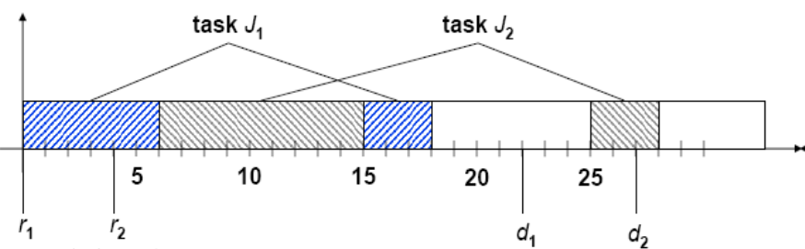
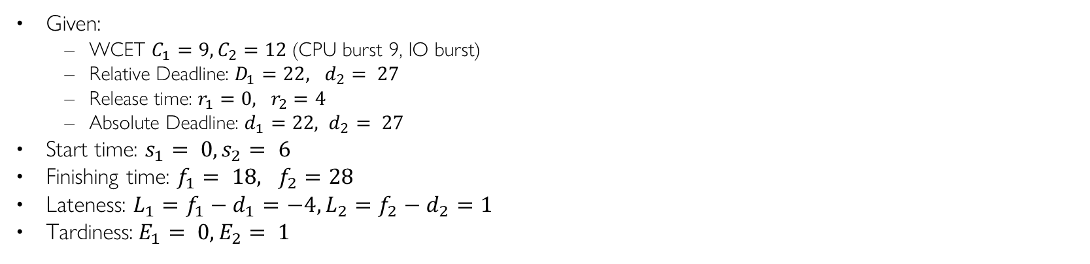
Given:
WCET $C_{1}=9, C_{2}=12$ (CPU burst 9, IO burst)
Relative Deadline: $D_{1}=22, d_{2}= 27$
Release time: $r_{1}=0, r_{2}=4$
Absolute Deadline: $d_{1}=22, d_{2}= 27$
Start time: $s_{1}= 0, s_{2}= 6$
Finishing time: $f_{1}= 18, f_{2}=28$
Lateness: $L_{1}=f_{1}−d_{1}=−4, L_{2}=f_{2}−d_{2}=1$
Tardiness:$E_{1}= 0, E_{2}= 1$

Slide 68
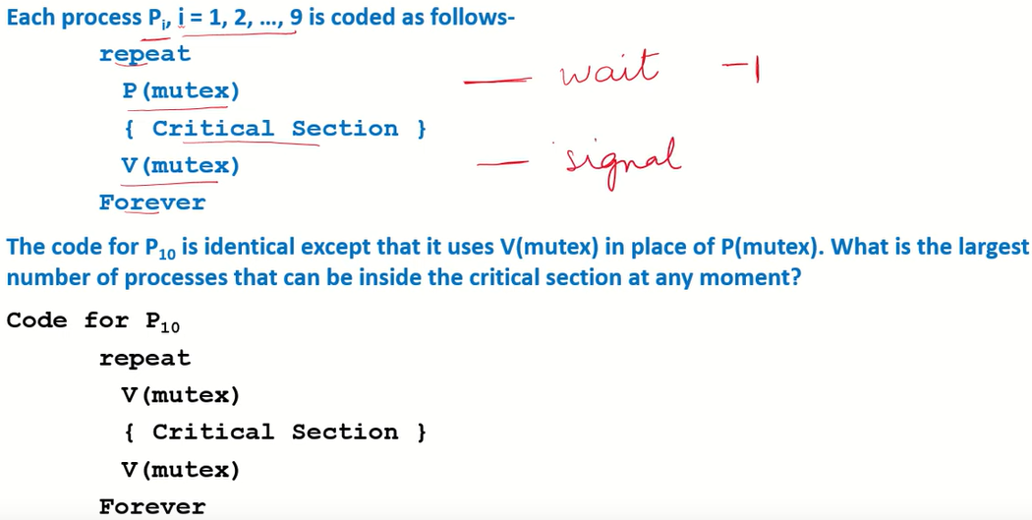
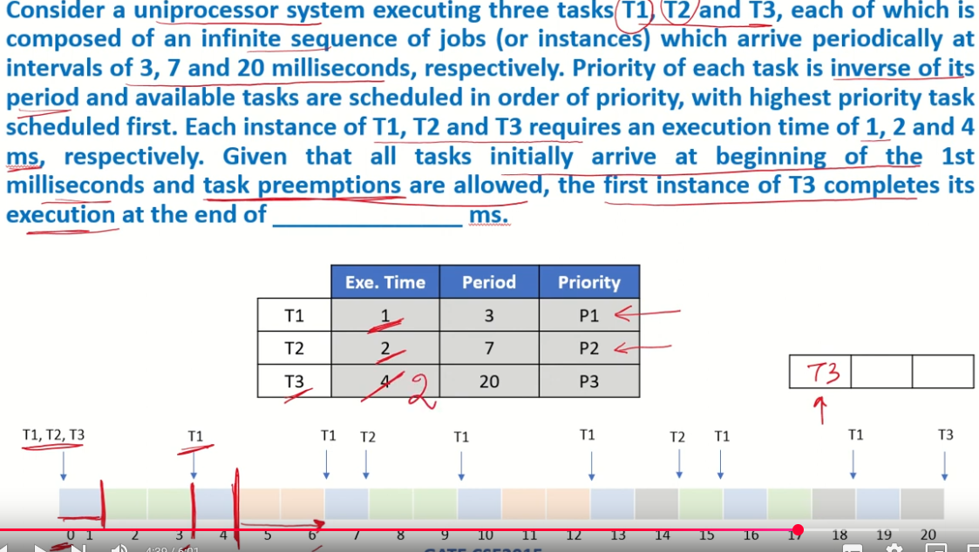
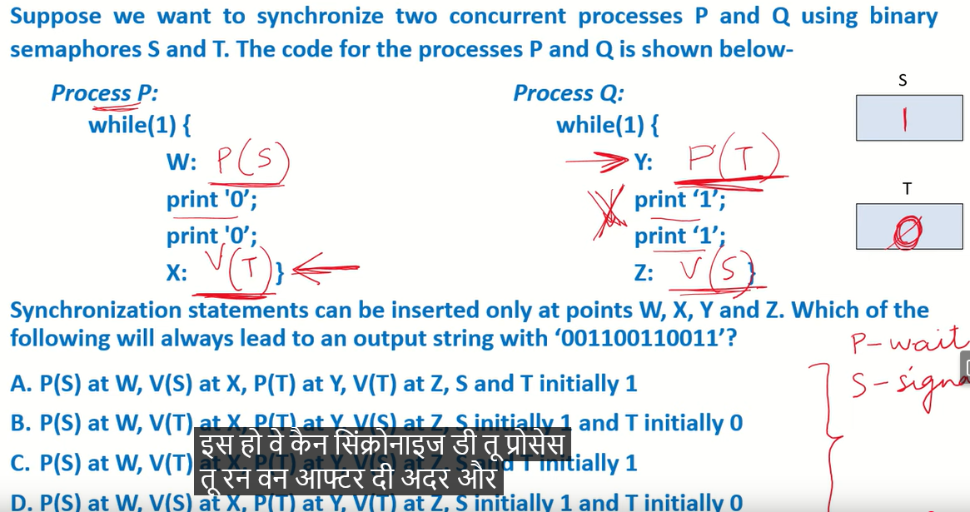
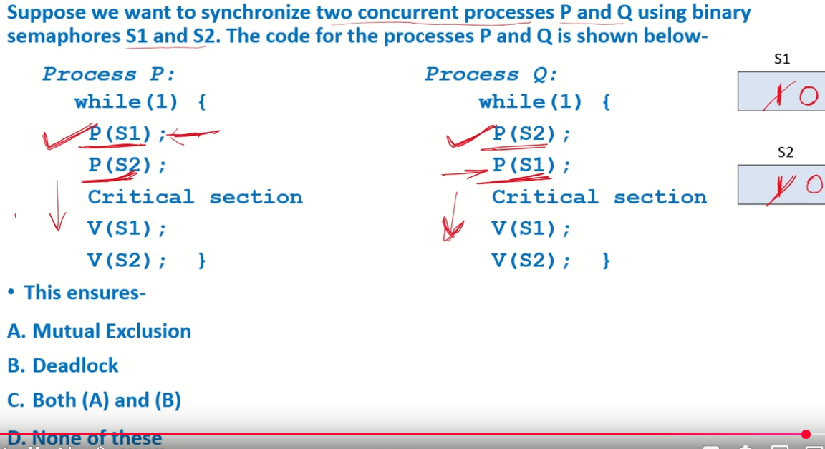
All 10 in CS
Make it short answer
Notes:
https://www.youtube.com/watch?v=8vSGKLMJiY8&list=PL1XjRDnU2tOipNUtu22aHUGC4SADqHrYF&index=34
https://www.youtube.com/watch?v=3G3PxbQkgHU&list=PL1XjRDnU2tOipNUtu22aHUGC4SADqHrYF&index=47
https://www.youtube.com/watch?v=JNLoB1ZHK_o&list=PL1XjRDnU2tOipNUtu22aHUGC4SADqHrYF&index=48
https://www.youtube.com/watch?v=oBpVm45B3Vs&list=PL1XjRDnU2tOipNUtu22aHUGC4SADqHrYF&index=50

Slide 69
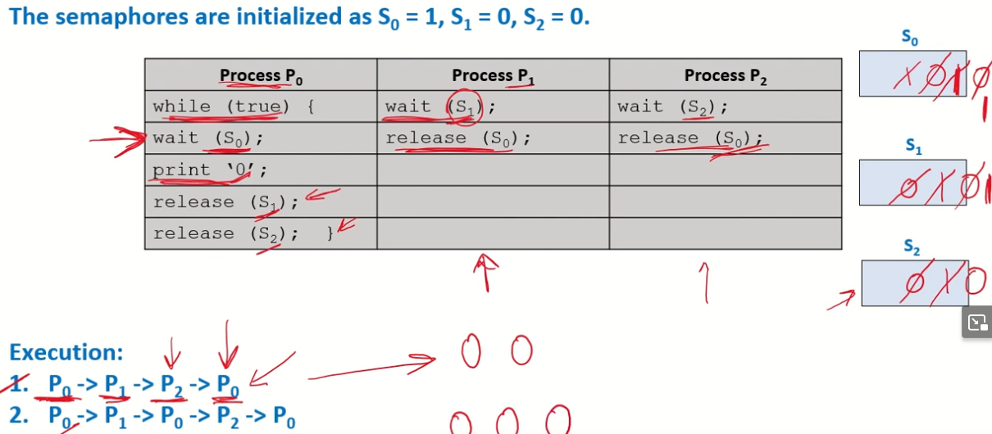
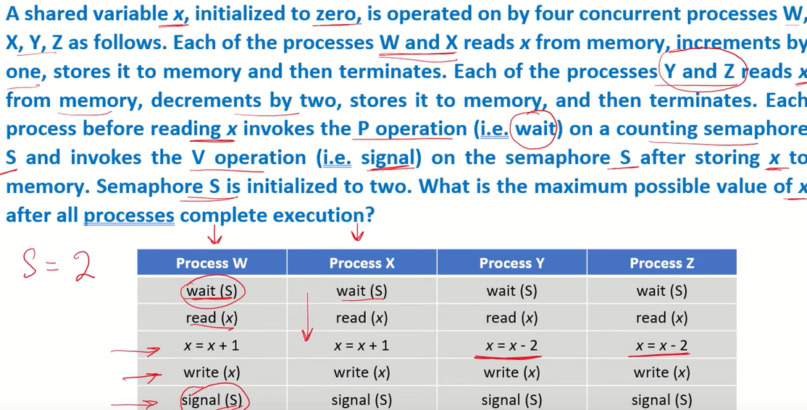
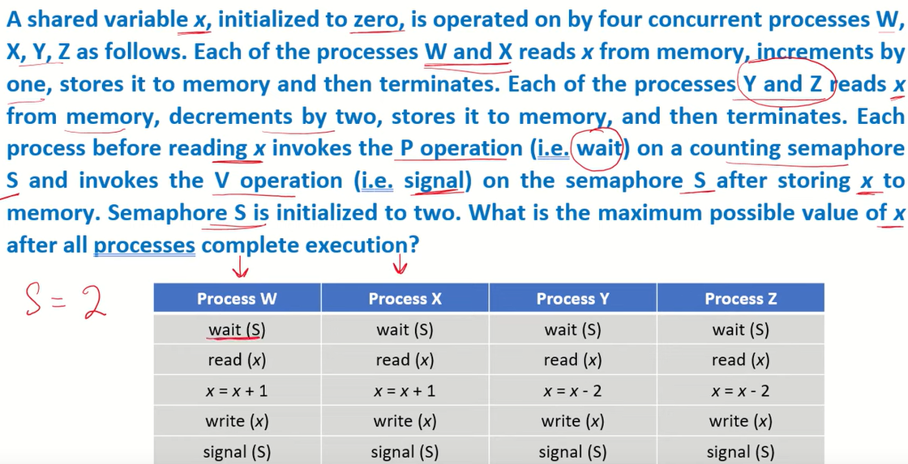
Init S to 1, then mutex is achieved. Init S to 2, no mutex
Notes:
https://www.youtube.com/watch?v=oBpVm45B3Vs&list=PL1XjRDnU2tOipNUtu22aHUGC4SADqHrYF&index=50
https://www.youtube.com/watch?v=WNWxnKFrku4&list=PL1XjRDnU2tOipNUtu22aHUGC4SADqHrYF&index=51
https://www.youtube.com/watch?v=WNWxnKFrku4&list=PL1XjRDnU2tOipNUtu22aHUGC4SADqHrYF&index=51

Slide 70
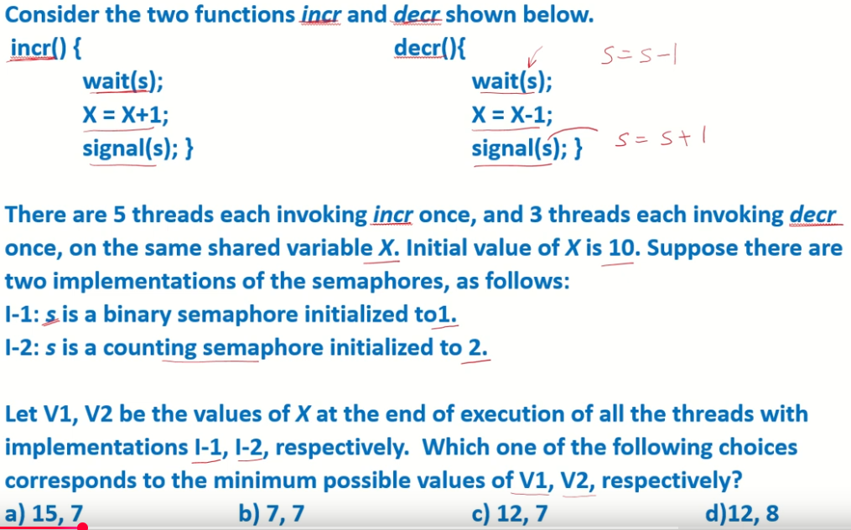
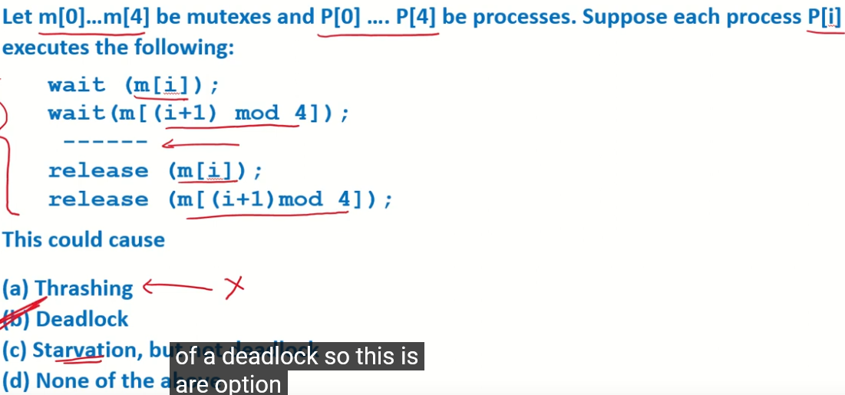
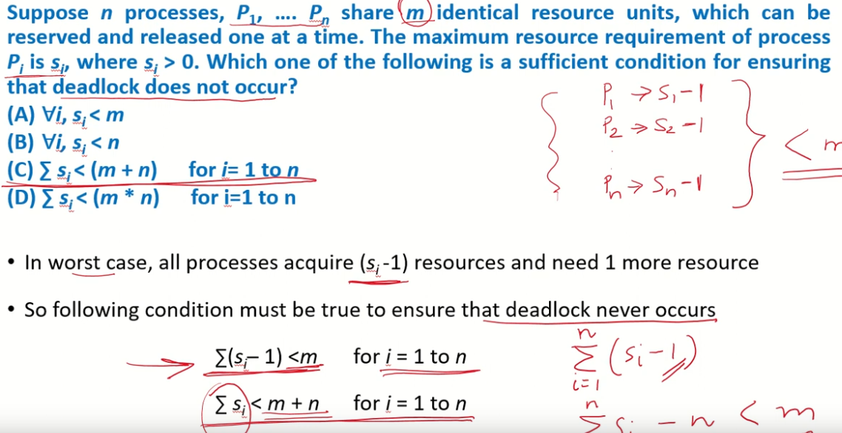
5 lawyers, Si=2, at least 6 chopsticks
Notes:
https://www.youtube.com/watch?v=rvOwt58_UwA&list=PL1XjRDnU2tOipNUtu22aHUGC4SADqHrYF&index=52
https://www.youtube.com/watch?v=e9fNOunGXYg&list=PL1XjRDnU2tOipNUtu22aHUGC4SADqHrYF&index=53

Slide 71
Quiz V Answer
Yes – if the block size gets too big, fetches become more expensive and the big blocks force out more useful data.
Certainly! That’s call “tuning”
“Most Recent” items ⇒ Temporal locality
For a given cache size: a larger block size can cause a lower hit rate than a smaller one.
If you know your computer’s cache size, you can often make your code run faster.
Memory hierarchies take advantage of spatial locality by keeping the most recent data items closer to the processor.
ABC
1: FFF
1: FFT
2: FTF
2: FTT
3: TFF
3: TFT
4: TTF
5: TTT

Slide 72
Quiz con’t
For a given cache size, a larger block size can cause a lower hit rate than a smaller one.
True. A large block size leads to fewer cache blocks.
If you know your computer’s cache size, you can often make your code run faster.
True. By tuning your code to be cache-aware.
Memory hierarchies take advantage of spatial locality by keeping the most recent data items closer to the processor.
False. This is called temporal locality.
Notes:
If the block size gets too big, fetches become more expensive and the big blocks force out more useful data.

Slide 73
Quiz: Fork
Q: How many Hellos are printed out in total? Draw the process family tree. In C, the logical AND operator (&&) employs short-circuit evaluation, meaning it evaluates expressions from left to right and stops as soon as the result of the entire expression is determined. Specifically for (cond1&&cond2): If cond1 evaluates to false (zero), the overall result of the && operation is already known to be false, so cond2 is not evaluated. If cond1 evaluates to true (non-zero), the evaluation proceeds to the next operand cond2.
A: There are 4 processes in total.
The initial process P0 calls pid1=fork() to create child process P1. P0 has pid1>0, so it calls pid2=fork() to create child process P2.
In P1, the if condition (pid1>0&&?) = (false&&?)=false, so p1 skips the call pid2=fork(), stops here and does not call any more fork(). (? stands for either true or false).
The if condition (pid1>0&&pid2>0) is checked in both P0 and P2. It is (true&&true)=true in P0, so P0 calls pid3=fork() to create child process P3. It is (true&&false)=false in P2, so P2 stops here and does not call any more fork().
1 #include <unistd.h>
2 int main (void) {
if(pid1=fork()>0&&pid2=fork()>0)
{pid3=fork();}
5 }
P0
59101
parent continues
59101
Call pid1=fork()
child
process created
pid1>0,
call pid2=fork()
59102
pid1==0,stop
P0
P1
“Hello”
pid1>0, pid2>0, call pid3=fork()
pid1>0, pid2==0,
stop
59101
59103
P0
P2
“Hello”
59101 59105
P0
P3
“Hello”
“Hello”

Slide 74
Quiz: Fork
#include <stdio.h>
#include <stdlib.h>
#include <sys/types.h>
#include <unistd.h>
int main()
{
int x = 1;
pid_t pid = fork();
if (pid == 0){
printf("Child has x = %d\n", ++x); }
else{
printf("Parent has x = %d\n",
--x); }
return 0;
}
Updates to global variable x in the parent process and child process do not affect each other because they have separate address spaces, and separate copies of data variables.
Since parent process and child process run concurrently without wait(), two output interleavings are possible.
Output:
Parent has x = 0
Child has x = 2
Or,
Child has x = 2
Parent has x = 0
Notes:
The number of times ‘hello’ is printed is equal to the number of processes created. Total Number of Processes = 2^{n}, where n is the number of fork system calls. So here n = 3, 2³ = 8 Let us put some label names for the three lines:’
Let us put some label names for the three lines:
fork (); // Line 1
fork (); // Line 2
fork (); // Line 3
L1 // 1 child process created by line 1.
/ \
L2 L2 // 2 child processes created by line 2.
/ \ / \
L3 L3 L3 L3 // 4 child processes created by line 3.
#include <stdio.h>
#include <stdlib.h>
#include <sys/types.h>
#include <unistd.h>
void forkexample()
{
int x = 1;
pid_t p = fork();
if(p<0){
perror("fork fail");
exit(1);
}
else if (p == 0)
printf("Child has x = %d\n", ++x);
else
printf("Parent has x = %d\n", --x);
}
int main()
{
forkexample();
return 0;
}

